Slide 1
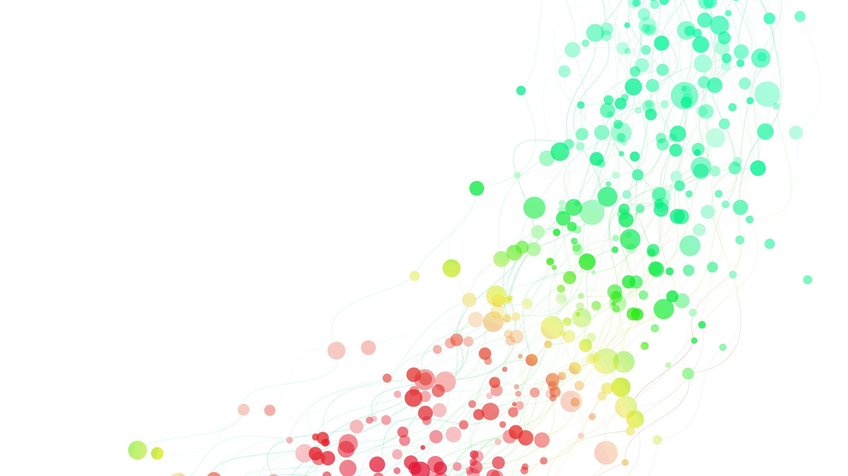
Market Price Prediction‏

Slide 2

INTRODUCTION
In the realm of market analysis and forecasting, understanding the intricate patterns within time series
data is paramount for informed decision-making. With the advent of machine learning techniques, it's
now possible to delve deeper into historical market data to predict future trends accurately. In this
context, we have at our disposal a dataset containing monthly market data spanning multiple years,
encompassing various regions, commodities, and pricing information.

Slide 3

PREPROCESSING
1 : Data Cleaning: Check if there null and remove it
2 : BinaryEncoder
3 : Divide To Dependant And Independent Variables
4 : Divide data to train data and test data

Slide 4
Exploratory data analysis
identifying seasonality,
anomalies within the data.

Slide 5

MODEL
Built a LSTM
Fit Training data to model
Prediction Model with test data

Slide 6
Evaluation
mean_absolute_error
mean_squared_error
root_mean_squared_error

Slide 7

OUTCOMES
The ultimate goal is to deploy a production-ready machine learning model capable of generating accurate
forecasts for market quantity and prices for future months. The insights derived from this model will aid
stakeholders in making data-driven decisions, optimizing inventory management, pricing strategies, and
resource allocation, thereby enhancing overall efficiency and profitability in the market ecosystem.

